Slide 1
All You Need is Java
Fast-paced Switchover from C++
Rubyeat Islam
rubyeat88@gmail.com
Notes:
‹#›

Slide 2
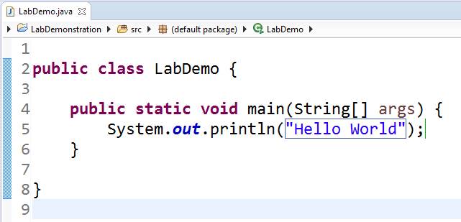
A Hello World Application
Notes:
‹#›

Slide 3
Data-types
Integers*: byte (1 byte), short(2 bytes), int (4 bytes), long(8 bytes)
Floating-point/ decimal value: float (4 bytes), double (8 bytes)
Characters: char (2 bytes)
true/ false: boolean (1 byte)
*Does not support unsigned (positive only) integers
Notes:
‹#›

Slide 4
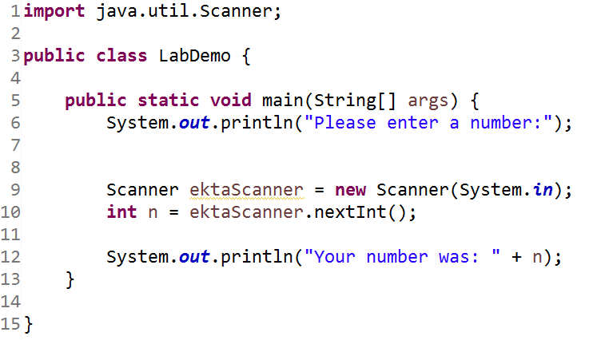
Taking input from user
Notes:
‹#›

Slide 5
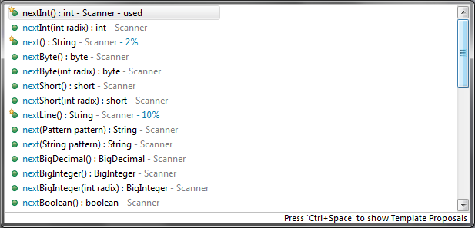
Taking input from user
Notes:
‹#›

Slide 6
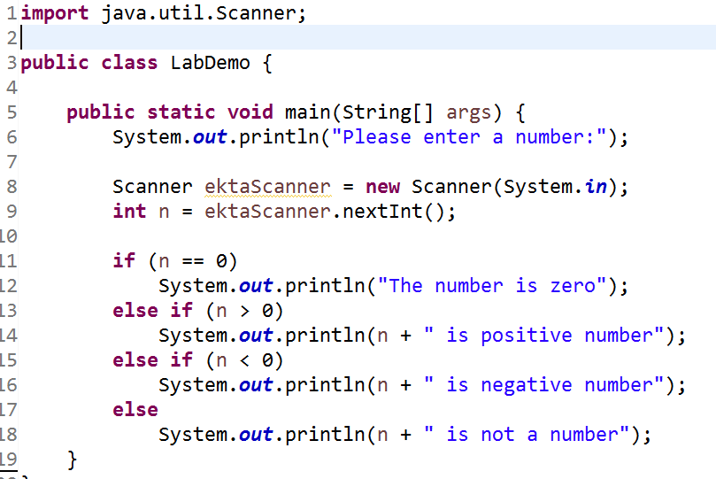
Control Statements (1/2)
Notes:
‹#›

Slide 7
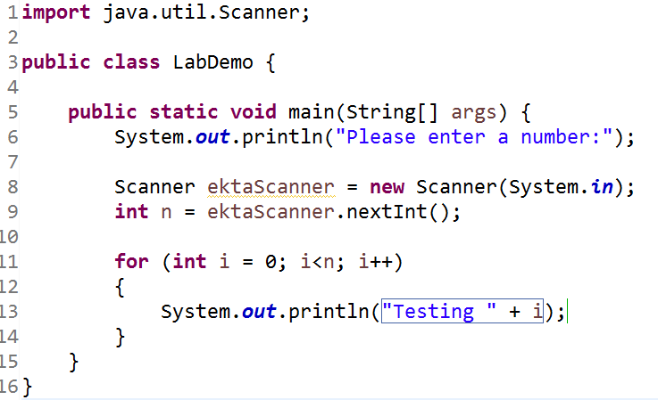
Control Statements (2/2)
Notes:
‹#›

Slide 8
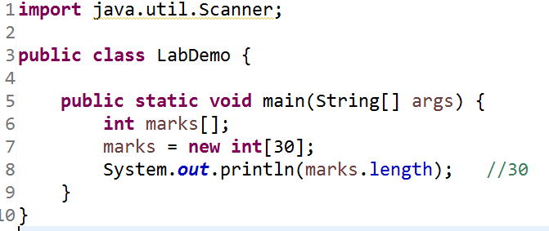
Arrays
Notes:
‹#›

Slide 9
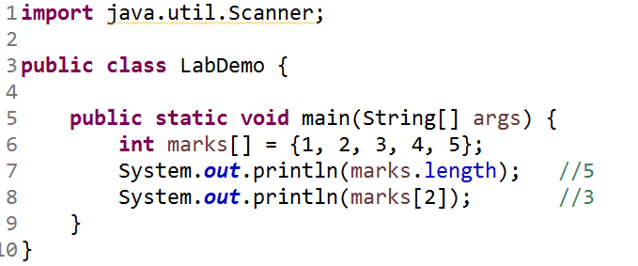
Arrays
Notes:
‹#›

Slide 10
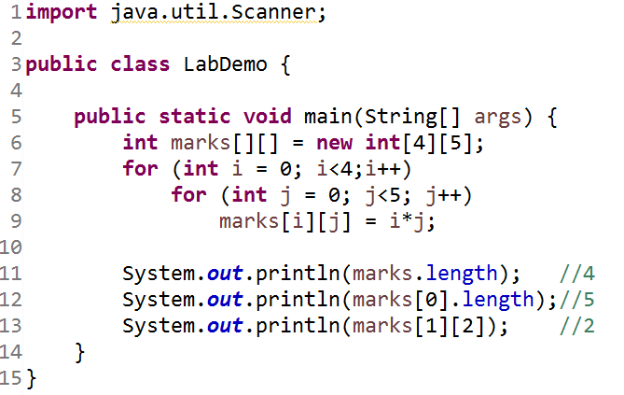
2D Array
Notes:
‹#›

Slide 11
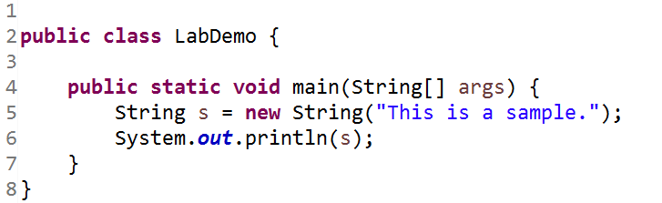
String
Notes:
‹#›

Slide 12
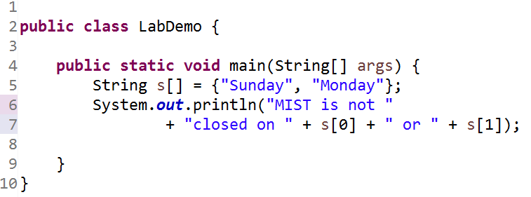
Array of String
Notes:
‹#›

